Slide 1
Topic 7 Efficiency, Environmental Concerns, and Mass Conservation
Thermodynamics: An Engineering Approach
8th Edition Yunus A. Çengel, Michael A. Boles
McGraw-Hill, 2015

Slide 2
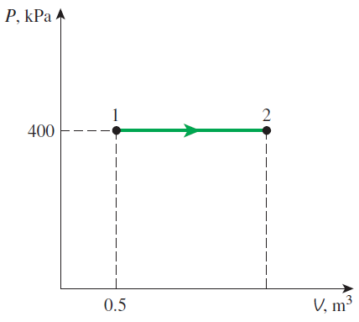
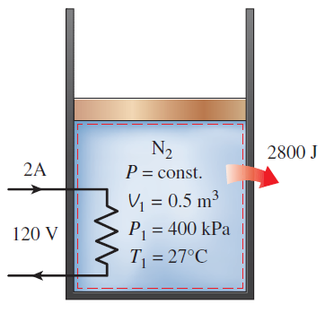
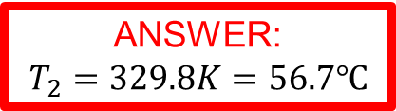
Practice Problem
A piston cylinder device initially contains 0.5 m³ of nitrogen gas at 400 kPa and 27ºC. An electric heater within the device uses 2A of current from a 120 V source for 5 minutes. As the nitrogen expands, a heat loss of 2800 J occurs during the process. Determine the final temperature.
ANSWER:
$$T_{2}=329.8K=56.7℃$$

Slide 3
Objectives
Define energy conversion efficiencies.
Discuss the implications of energy conversion on the environment.
Develop the conservation of mass principle.
Apply the conservation of mass principle to various systems including steady- and unsteady-flow control volumes.
Apply the first law of thermodynamics as the statement of the conservation of energy principle to control volumes.
Identify the energy carried by a fluid stream crossing a control surface as the sum of internal energy, flow work, kinetic energy, and potential energy of the fluid and to relate the combination of the internal energy and the flow work to the property enthalpy.

Slide 4
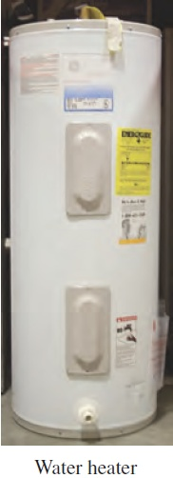

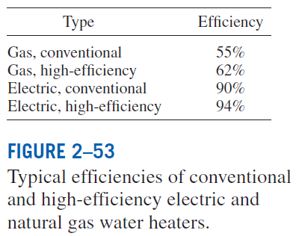
ENERGY CONVERSION EFFICIENCIES
Efficiency is one of the most frequently used terms in thermodynamics, and it indicates how well an energy conversion or transfer process is accomplished.
Efficiency of a water heater: The ratio of the energy delivered to the house by hot water to the energy supplied to the water heater.

Slide 5

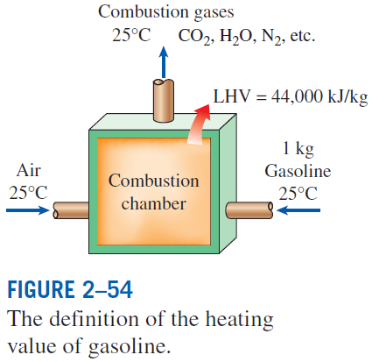
Heating value of the fuel: The amount of heat released when a unit amount of fuel at room temperature is completely burned and the combustion products are cooled to the room temperature.
Lower heating value (LHV): When the water leaves as a vapor.
Higher heating value (HHV): When the water in the combustion gases is completely condensed and thus the heat of vaporization is also recovered.
The efficiency of space heating systems of residential and commercial buildings is usually expressed in terms of the annual fuel utilization efficiency (AFUE), which accounts for the combustion efficiency as well as other losses such as heat losses to unheated areas and start-up and cooldown losses.

Slide 6

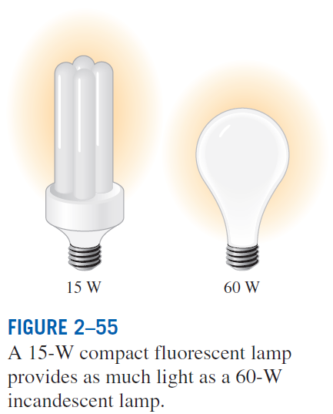
Overall efficiency of a power plant
Generator: A device that converts mechanical energy to electrical energy.
Generator efficiency: The ratio of the electrical power output to the mechanical power input.
Thermal efficiency of a power plant: The ratio of the net electrical power output to the rate of fuel energy input.

Slide 7
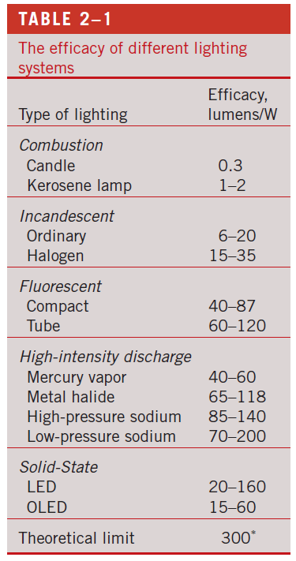
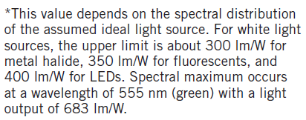
Lighting efficacy: The amount of light output in lumens per W of electricity consumed.

Slide 8
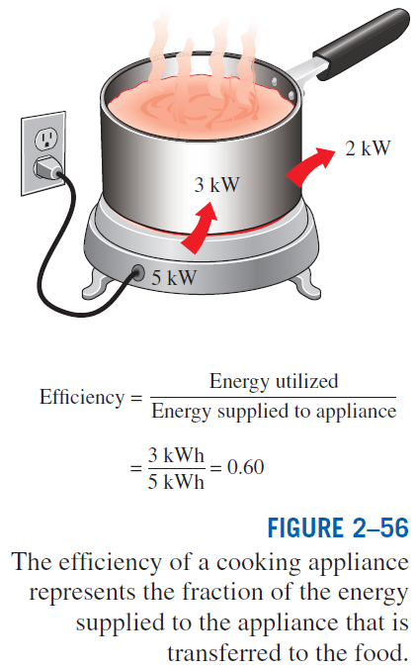
Using energy-efficient appliances conserve energy.
It helps the environment by reducing the amount of pollutants emitted to the atmosphere during the combustion of fuel.
The combustion of fuel produces
carbon dioxide, causes global warming
nitrogen oxides and hydrocarbons, cause smog
carbon monoxide, toxic
sulfur dioxide, causes acid rain.

Slide 9
Example The efficiency of cooking appliances affects the internal heat gain from them since an inefficient appliance consumes a greater amount of energy for the same task, and the excess energy consumed shows up as heat in the living space. The efficiency of open burners is determined to be 73 percent for electric units and 38 percent for gas units. Consider a 2-kW electric burner at a location where the unit costs of electricity and natural gas are $0.09/kWh and $1.20/therm, respectively. Determine the rate of energy consumption by the burner and the unit cost of utilized energy for both electric and gas burners. Note: 1 therm = 29.3 kWh
Example 1

Slide 10
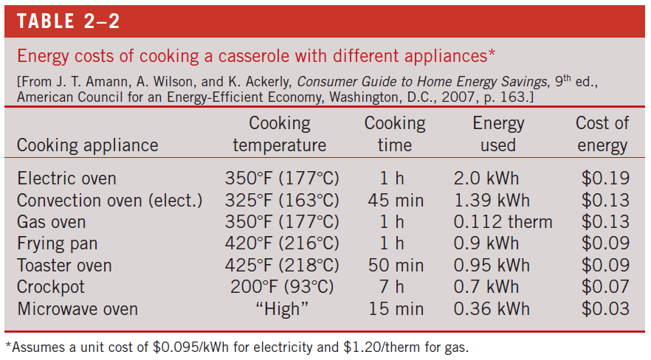

Slide 11
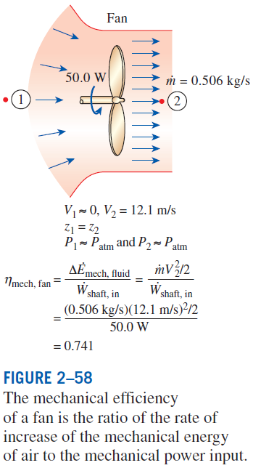
Efficiencies of Mechanical and Electrical Devices
Mechanical efficiency
The effectiveness of the conversion process between the mechanical work supplied or extracted and the mechanical energy of the fluid is expressed by the pump efficiency and turbine efficiency,

Slide 12
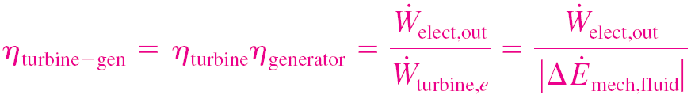
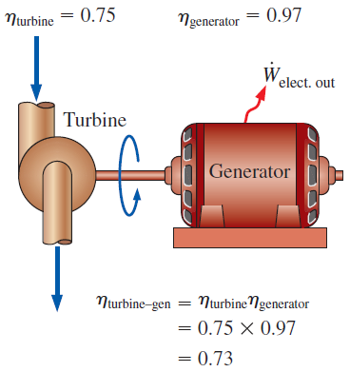
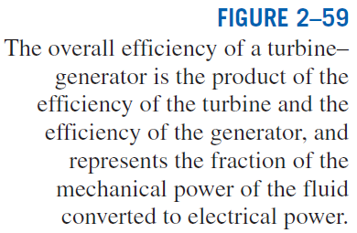
Pump efficiency
Generator efficiency
Pump-Motor overall efficiency
Turbine-Generator overall efficiency

Slide 13
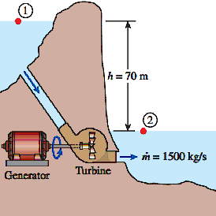
Example Electric power is to be generated by installing a hydraulic turbine–generator at a site 70 m below the free surface of a large water reservoir that can supply water at a rate of 1500 kg/s steadily. If the mechanical power output of the turbine is 800 kW and the electric power generation is 750 kW, determine the turbine efficiency and the combined turbine-generator efficiency of this plant. Neglect losses in the pipes.
Example 2

Slide 14
ENERGY AND ENVIRONMENT
The conversion of energy from one form to another often affects the environment and the air we breathe in many ways, and thus the study of energy is not complete without considering its impact on the environment.
Pollutants emitted during the combustion of fossil fuels are responsible for smog, acid rain, and global warming.
The environmental pollution has reached such high levels that it became a serious threat to vegetation, wild life, and human health.

Slide 15
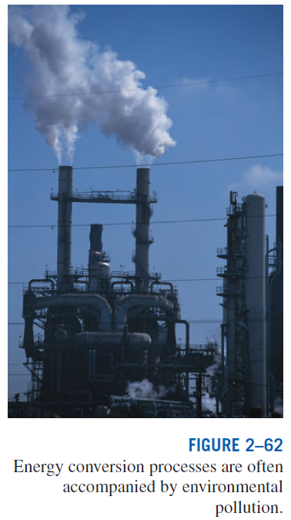
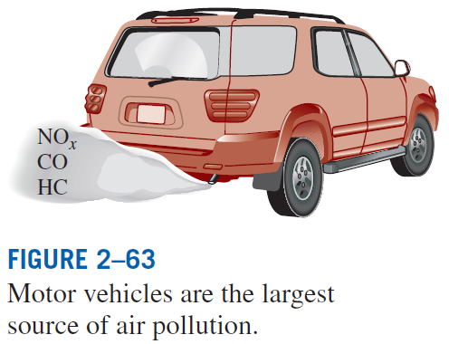

Slide 16
Ozone and Smog
Smog: Made up mostly of ground-level ozone (O₃), but it also contains numerous other chemicals, including carbon monoxide (CO), particulate matter such as soot and dust, volatile organic compounds (VOCs) such as benzene, butane, and other hydrocarbons.
Hydrocarbons and nitrogen oxides react in the presence of sunlight on hot calm days to form ground-level ozone.
Ozone irritates eyes and damages the air sacs in the lungs where oxygen and carbon dioxide are exchanged, causing eventual hardening of this soft and spongy tissue.
It also causes shortness of breath, wheezing, fatigue, headaches, and nausea, and aggravates respiratory problems such as asthma.
The other serious pollutant in smog is carbon monoxide, which is a colorless, odorless, poisonous gas.
It is mostly emitted by motor vehicles.
It deprives the body’s organs from getting enough oxygen by binding with the red blood cells that would otherwise carry oxygen. It is fatal at high levels.
Suspended particulate matter such as dust and soot are emitted by vehicles and industrial facilities. Such particles irritate the eyes and the lungs.

Slide 17
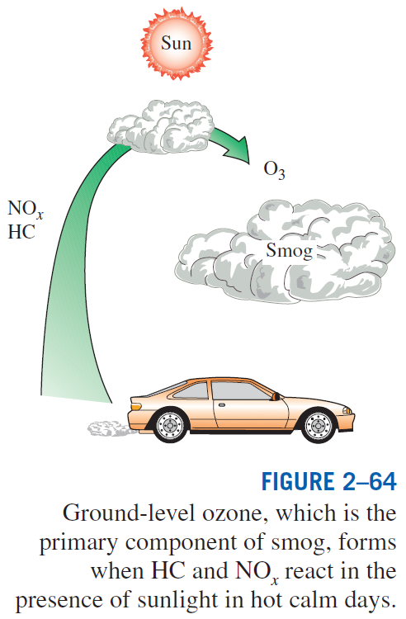

Slide 18
Acid Rain
The sulfur in the fuel reacts with oxygen to form sulfur dioxide (SO₂), which is an air pollutant.
The main source of SO₂ is the electric power plants that burn high-sulfur coal.
Motor vehicles also contribute to SO₂ emissions since gasoline and diesel fuel also contain small amounts of sulfur.
The sulfur oxides and nitric oxides react with water vapor and other chemicals high in the atmosphere in the presence of sunlight to form sulfuric and nitric acids.
The acids formed usually dissolve in the suspended water droplets in clouds or fog.
These acid-laden droplets, which can be as acidic as lemon juice, are washed from the air on to the soil by rain or snow. This is known as acid rain.

Slide 19
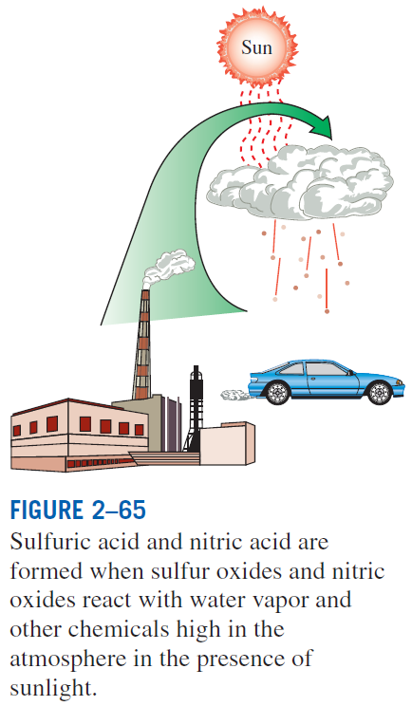

Slide 20
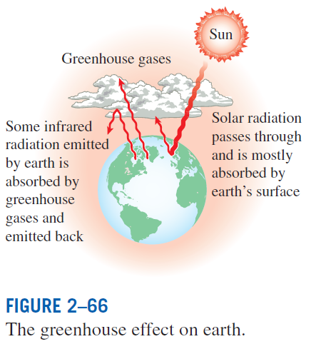
The Greenhouse Effect: Global Warming and Climate Change
Greenhouse effect: Glass allows the solar radiation to enter freely but blocks the infrared radiation emitted by the interior surfaces. This causes a rise in the interior temperature as a result of the thermal energy buildup in a space (i.e., car).
The surface of the earth, which warms up during the day as a result of the absorption of solar energy, cools down at night by radiating part of its energy into deep space as infrared radiation.
Carbon dioxide (CO₂), water vapor, and trace amounts of some other gases such as methane and nitrogen oxides act like a blanket and keep the earth warm at night by blocking the heat radiated from the earth. The result is global warming.
These gases are called “greenhouse gases,” with CO₂ being the primary component.
CO₂ is produced by the burning of fossil fuels such as coal, oil, and natural gas.

Slide 21
A 1995 report: The earth has already warmed about 0.5°C during the last century, and they estimate that the earth’s temperature will rise another 2°C by the year 2100.
A rise of this magnitude can cause severe changes in weather patterns with storms and heavy rains and flooding at some parts and drought in others, major floods due to the melting of ice at the poles, loss of wetlands and coastal areas due to rising sea levels, and other negative results.
Improved energy efficiency,
energy conservation,
using renewable energy sources
help minimize global warming.

Slide 22
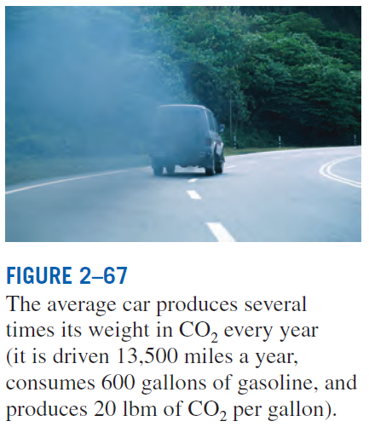
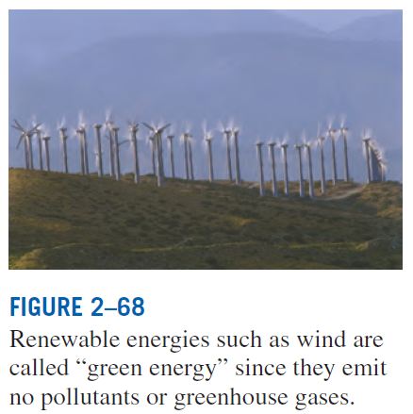

Slide 23
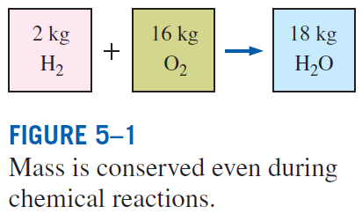
CONSERVATION OF MASS
Conservation of mass: Mass, like energy, is a conserved property, and it cannot be created or destroyed during a process.
Closed systems: The mass of the system remain constant during a process.
Control volumes: Mass can cross the boundaries, and so we must keep track of the amount of mass entering and leaving the control volume.
Mass m and energy E can be converted to each other according to
where c is the speed of light in a vacuum, which is c = 2.9979 × 10⁸ m/s.
The mass change due to energy change is negligible.

Slide 24

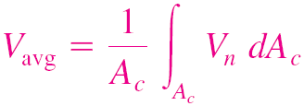
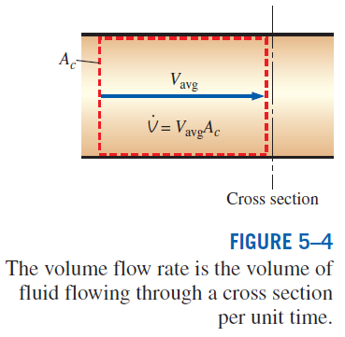
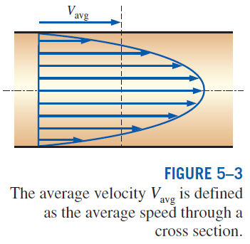
Mass and Volume Flow Rates
Definition of average velocity
Volume flow rate
Mass flow rate

Slide 25
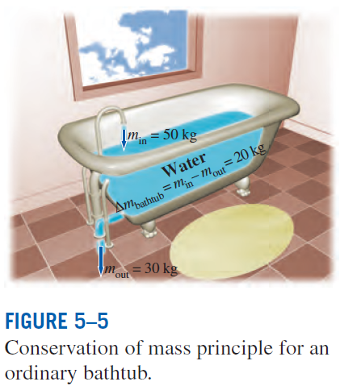

Conservation of Mass Principle
The conservation of mass principle for a control volume: The net mass transfer to or from a control volume during a time interval Δt is equal to the net change (increase or decrease) in the total mass within the control volume during Δt.
These equations are often referred to as the mass balance and are applicable to any control volume undergoing any kind of process.

Slide 26
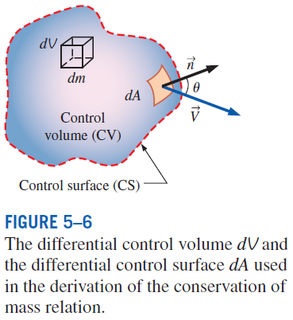






the time rate of change of mass within the control volume plus the net mass flow rate through the control surface is equal to zero.
General conservation of mass in rate form

Slide 27
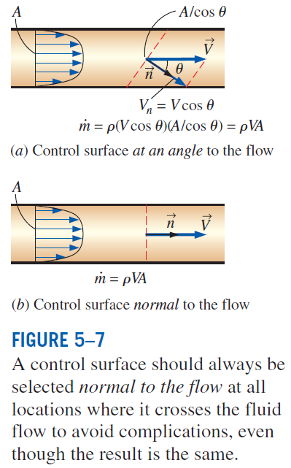

Slide 28
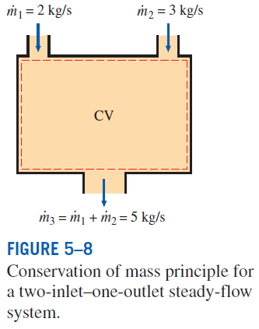
Mass Balance for Steady-Flow Processes
During a steady-flow process, the total amount of mass contained within a control volume does not change with time (m_{CV} = constant).
Then the conservation of mass principle requires that the total amount of mass entering a control volume equal the total amount of mass leaving it.
For steady-flow processes, we are interested in the amount of mass flowing per unit time, that is, the mass flow rate.
Multiple inlets and exits
Single stream
Many engineering devices such as nozzles, diffusers, turbines, compressors, and pumps involve a single stream (only one inlet and one outlet).

Slide 29
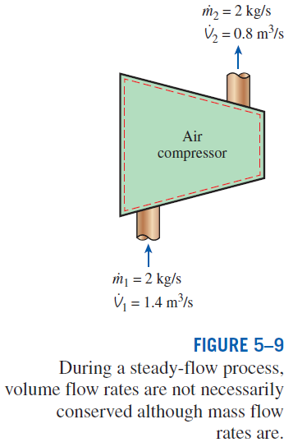
Special Case: Incompressible Flow
The conservation of mass relations can be simplified even further when the fluid is incompressible, which is usually the case for liquids.
Steady, incompressible
Steady, incompressible flow (single stream)
There is no such thing as a “conservation of volume” principle.
For steady flow of liquids, the volume flow rates, as well as the mass flow rates, remain constant since liquids are essentially incompressible substances.

Slide 30
Water Flow through a Hose Nozzle
A garden hose with a nozzle is used to fill a 10-gal bucket. The inner diameter of the hose is 2 cm and the diameter of the nozzle exit is 0.8 cm. If it takes 50 seconds to fill the bucket, determine (a) the volume and mass flow rates of water through the hose, (b) the average velocity of water inside the hose, and (c) the average velocity of water at the nozzle exit. (3.7854 L = 1 gallon)
Example 3

Slide 31
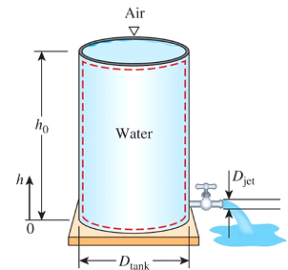
Discharge of Water from a Tank
A 4 ft high, 3 ft diameter cylindrical water tank whose top is open to the atmosphere is being drained. The diameter of the water jet that streams out the bottom is 0.5 in. Determine the velocity of the water leaving the tank and the time it takes to drain half of the tank.
Example 4

Slide 32
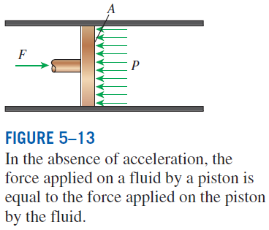
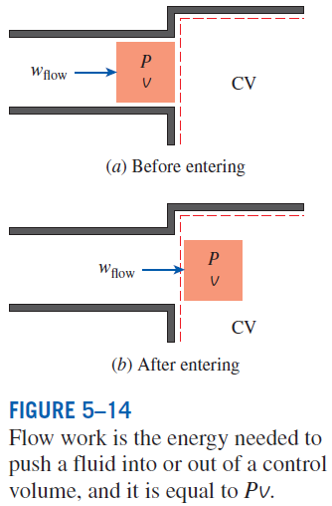
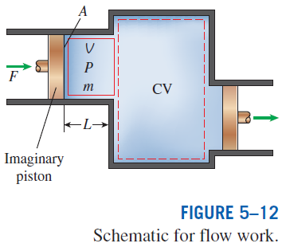
FLOW WORK AND THE ENERGY OF A FLOWING FLUID
Flow work, or flow energy: The work (or energy) required to push the mass into or out of the control volume. This work is necessary for maintaining a continuous flow through a control volume.

Slide 33
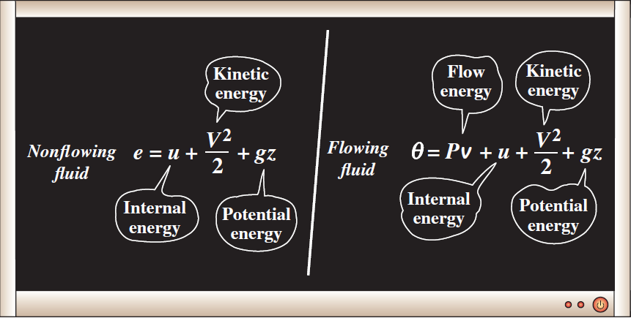
Total Energy of a Flowing Fluid
The flow energy is automatically taken care of by enthalpy. In fact, this is the main reason for defining the property enthalpy.
h = u + Pv
The total energy consists of three parts for a nonflowing fluid and four parts for a flowing fluid.

Slide 34
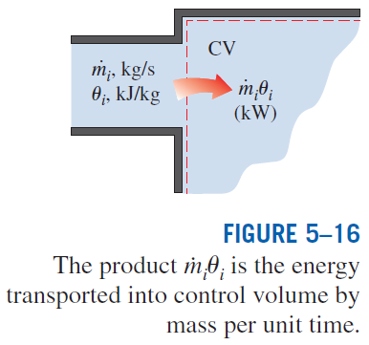

Energy Transport by Mass
When the kinetic and potential energies of a fluid stream are negligible
When the properties of the mass at each inlet or exit change with time as well as over the cross section

Slide 35
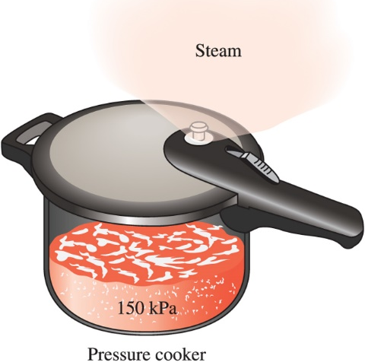
Energy Transport in a Pressure Cooker
Steam is leaving a 4 L pressure cooker whose operating pressure is 150 kPa. It is observed that the amount of liquid in the cooker has decreased by 0.6 L in 40 minutes during the steady operating conditions. The cross-sectional area of the exit opening is 8 mm². Determine (a) the mass flow rate of the steam and the exit velocity, (b) the flow and total energies of the steam (per unit mass), and (c) the rate at which energy leaves the cooker by steam.
Example 5

Slide 36
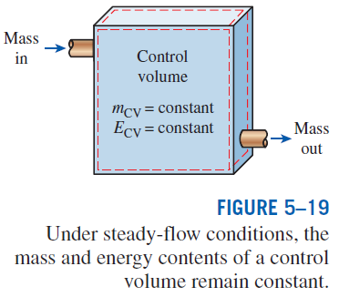
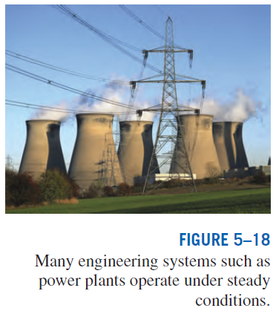
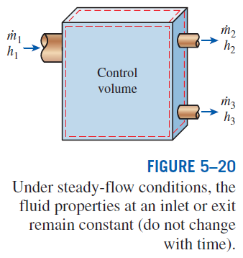
ENERGY ANALYSIS OF STEADY-FLOW SYSTEMS
Steady-flow process: A process during which a fluid flows through a control volume steadily.

Slide 37
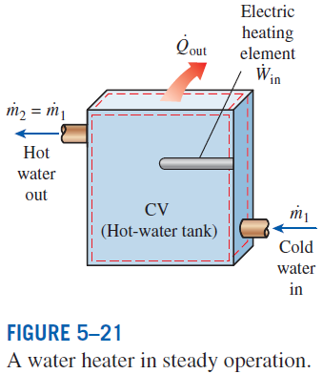


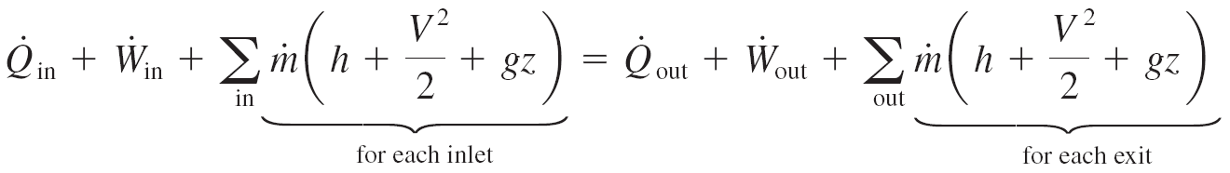
Mass and Energy balances for a steady-flow process
Mass balance
Energy balance

Slide 38
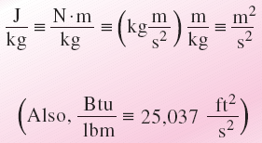
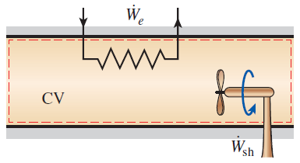
Energy balance relations with sign conventions (i.e., heat input and work output are positive)
The units m²/s² and J/kg
are equivalent.
when kinetic and potential energy changes are negligible
Under steady operation, shaft work and electrical work are the only forms of work a simple compressible system may involve.
At very high velocities, even small changes in velocities can cause significant changes in the kinetic energy of the fluid.

Slide 39
Summary
Energy conversion efficiencies
Efficiencies of mechanical and electrical devices (turbines, pumps)
Energy and environment
Ozone and smog
Acid rain
The Greenhouse effect: Global warming and climate change
Conservation of mass
Mass and volume flow rates
Mass balance for a steady-flow process
Mass balance for incompressible flow
Flow work and the energy of a flowing fluid
Energy transport by mass
Energy analysis of steady-flow systems

